Slide 1
In Silico Comparison of Photons versus Carbon Ions in Single Fraction Therapy of Lung Cancer
Kristjan Anderle

Slide 2
Outline
Introduction
Lung Cancer Patients – General Group
Lung Cancer Patients with Multiple Tumors
Conclusion & Outlook

Slide 3
Outline
Introduction
Lung Cancer Patients – General Group
Lung Cancer Patients with Multiple Tumors
Conclusion & Outlook

Slide 4
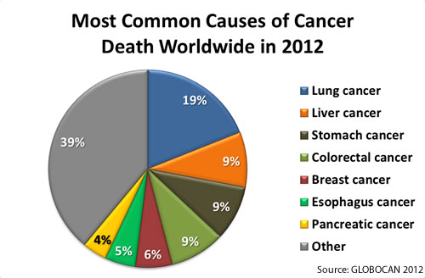
Introduction

Slide 5
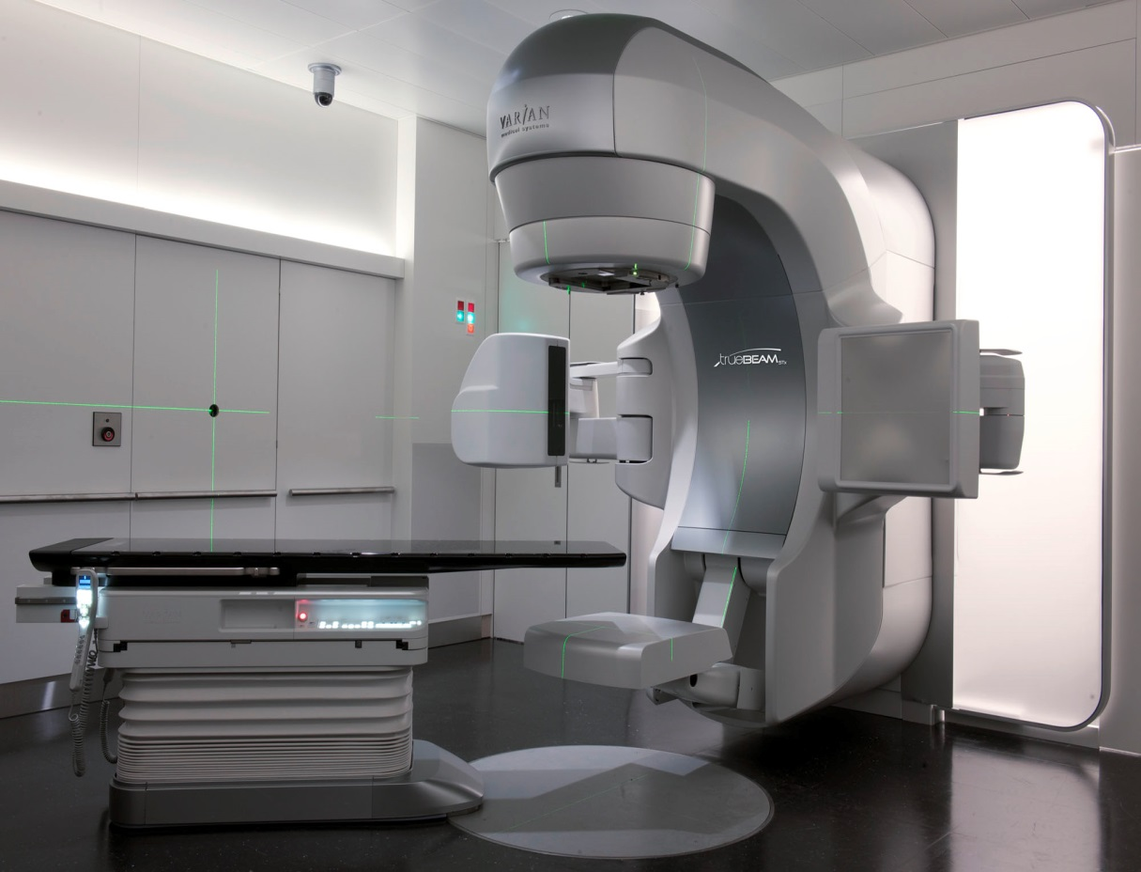

Stereotactic Body Radiation Treatment (SBRT)

Slide 6
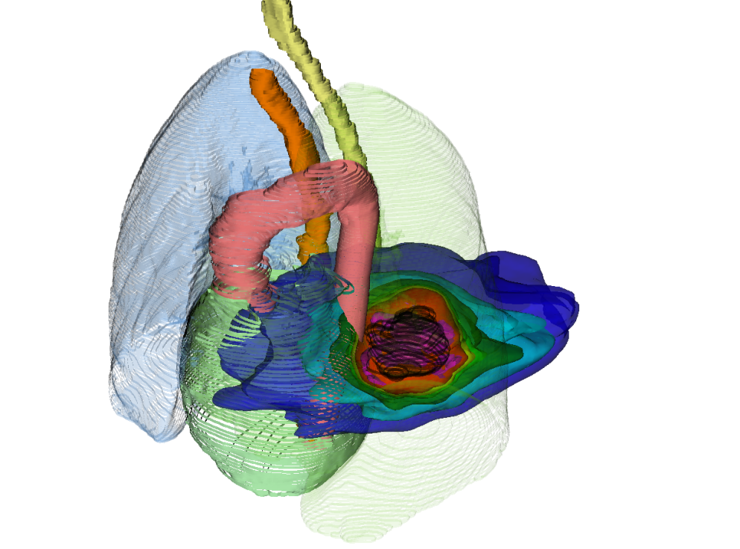
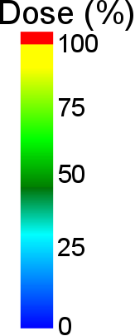
3D Treatment Plan Example
SBRT

Slide 7
3D Treatment Plan Example
SBRT
¹²C
photons
p+

Slide 8
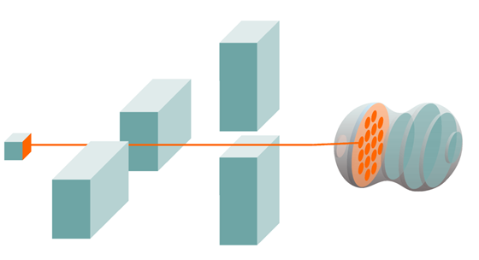
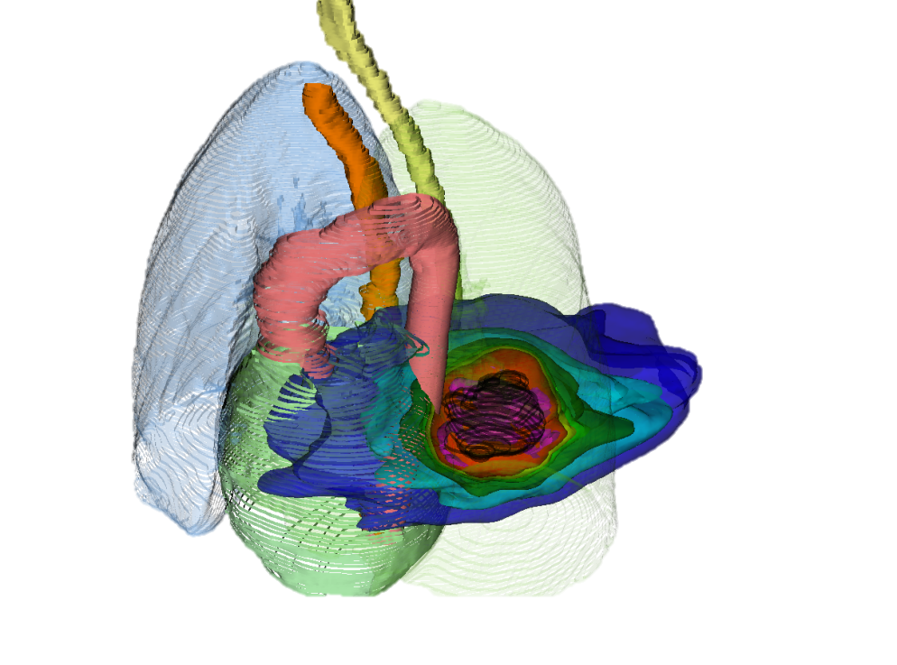
3D Treatment Plan Example
SBRT
12C
photons
p+

Slide 9
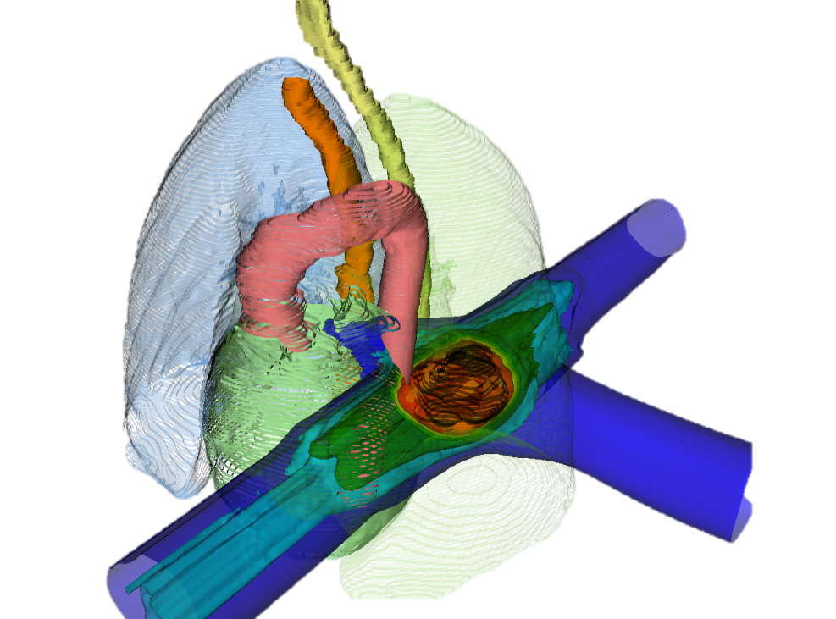
3D Treatment Plan Example
SBRT
¹²C
12C
photons
p+

Slide 10
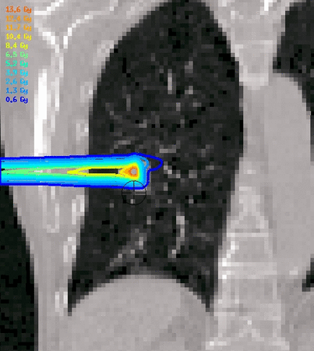
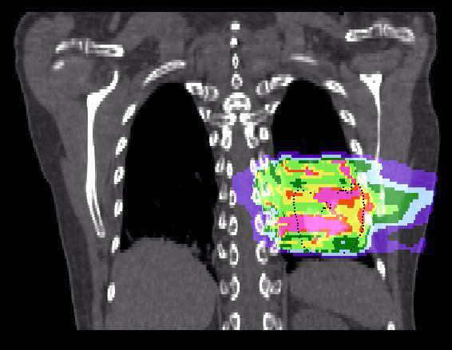
Motion effects
Courtesy M. Söhn, LMU
Courtesy C. Graeff, GSI

Slide 11
In Silico Comparison
23 lung cancer patients were actually treated with SBRT
Treatment plans were generated for active scanning carbon-ions (PT)
Comparision:
Dose to the tumor
Dose to critical organs
Dose escalation

Slide 12
Outline
Introduction
Lung Cancer Patients – General Group
Lung Cancer Patients with Multiple Tumors
Conclusion & Outlook

Slide 13
Outline
Introduction
Lung Cancer Patients – General Group
Lung Cancer Patients with Multiple Tumors
Conclusion & Outlook

Slide 14
Patient Data
19 patients, 26 tumors (each tumor 1 x 24 Gy)
Average tumor volume: 2.9 cm³
Average tumor motion: 3.1 mm
Single field uniform optimization
LEM IV biological model

Slide 15
Dose calculations
SBRT single treatment plan
PT 10 dose calculations per patient:
Without motion, static (2x)

Slide 16
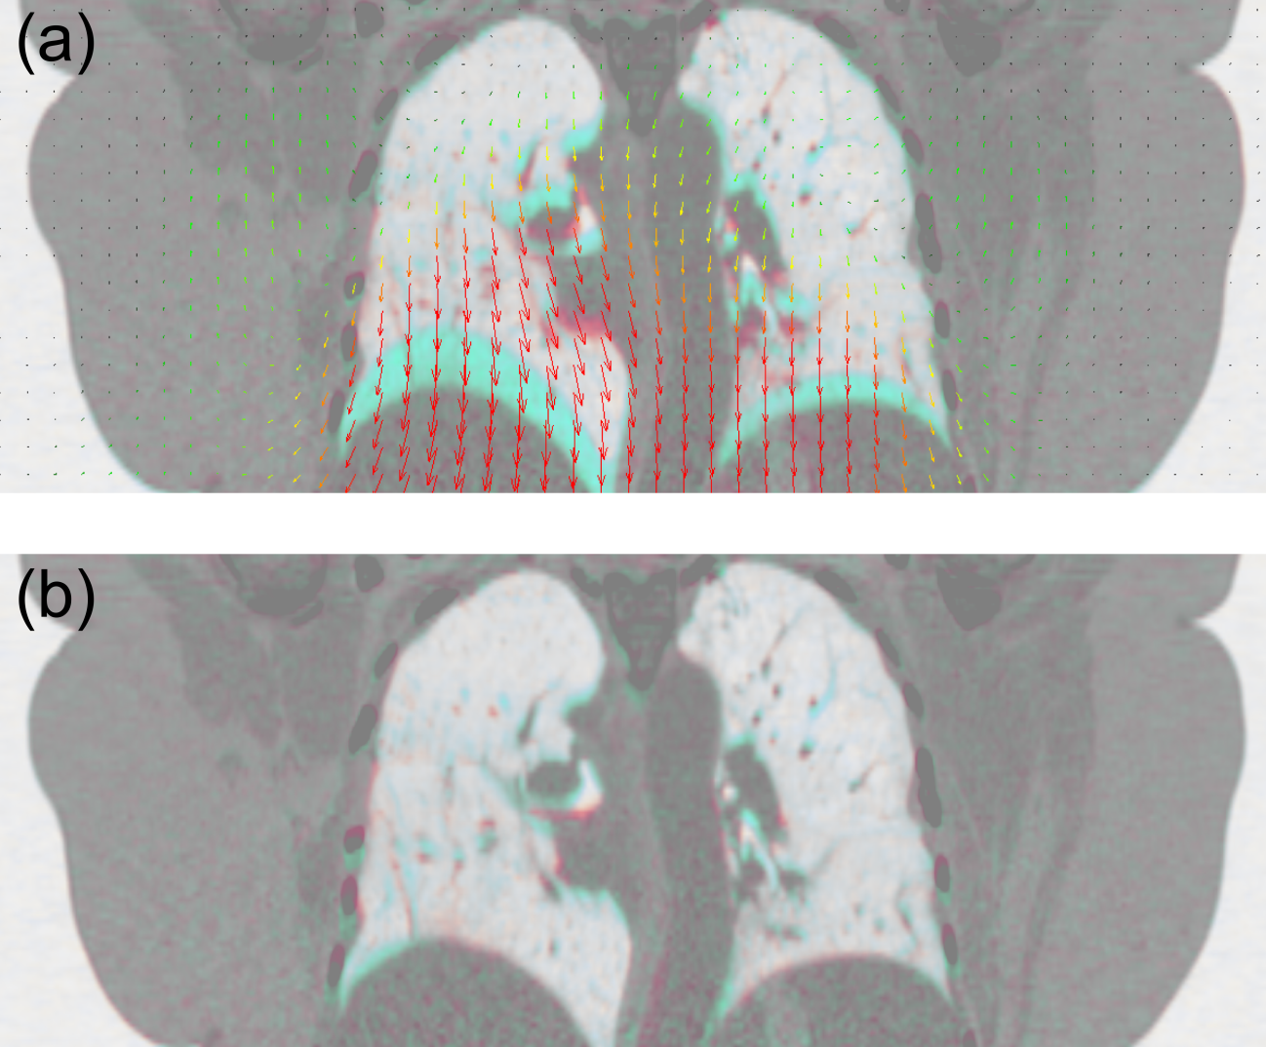
Deformable Image Registration & Quality Assurance
Before registration:
After registration:

Slide 17
Deformable Image Registration & Quality Assurance
Before registration:
After registration:

Slide 18
Dose calculations
SBRT single treatment plan
PT 10 dose calculations per patient:
Without motion, static (2x)
With motion, without compensation, 4D-interplay (4x)
With motion, with compensation, 4D-rescanning (4x)

Slide 19
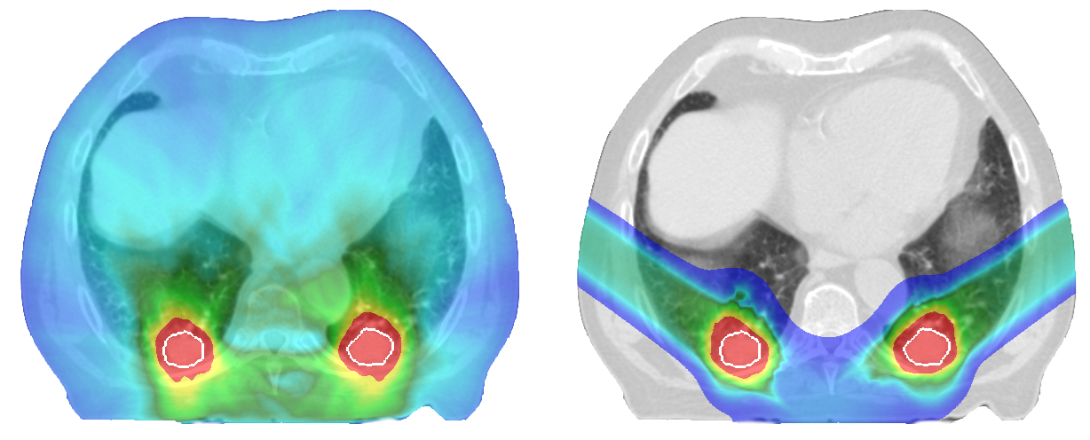
Results - Examples
SBRT
PT

Slide 20
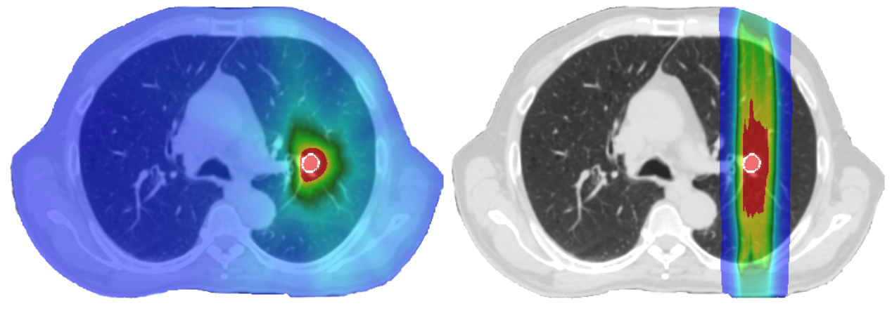
Results - Examples
SBRT
PT

Slide 21
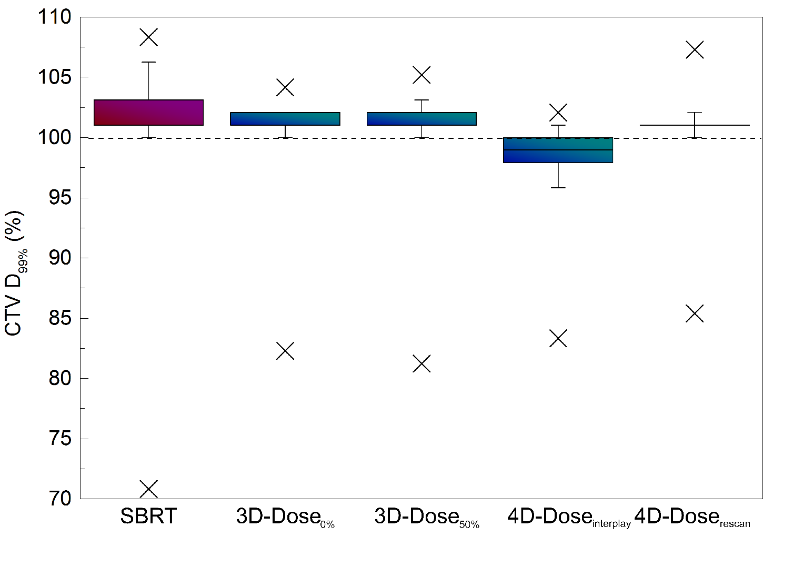
Results – Dose to Tumors

Slide 22
Results - Dose to Critical Organs

Slide 23
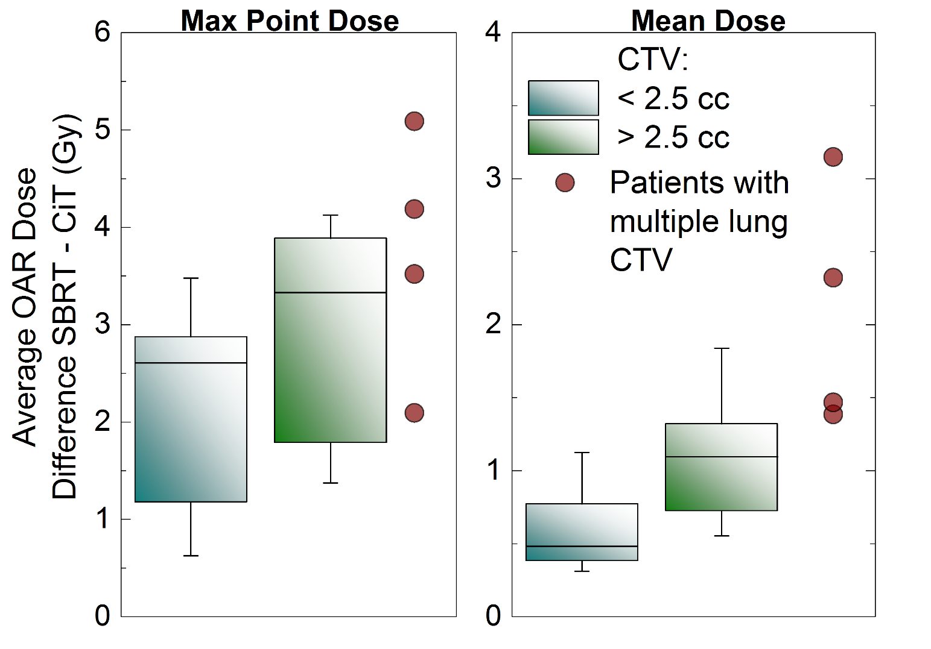
Results - Dose to Critical Organs
Notes:
CiT v PT

Slide 24
Outline
Introduction
Lung Cancer Patients – General Group
Lung Cancer Patients with Multiple Tumors
Conclusion & Outlook

Slide 25
Outline
Introduction
Lung Cancer Patients – General Group
Lung Cancer Patients with Multiple Tumors
Conclusion & Outlook

Slide 26
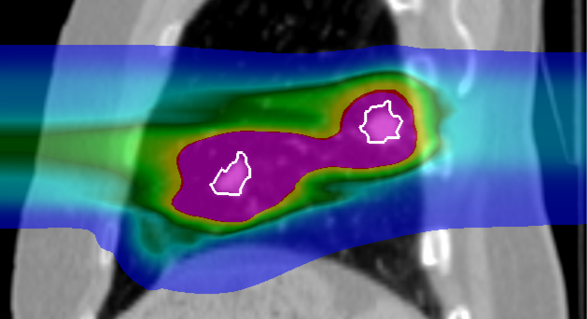
Intensity Modulated Particle Therapy Optimization for Multiple Targets

Slide 27
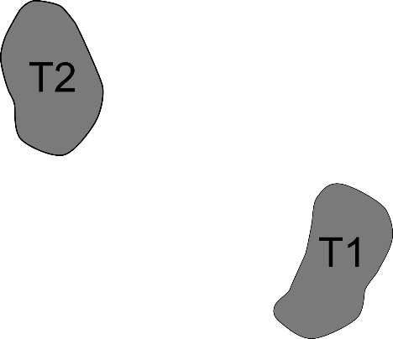
Intensity Modulated Particle Therapy Optimization for Multiple Targets

Slide 28
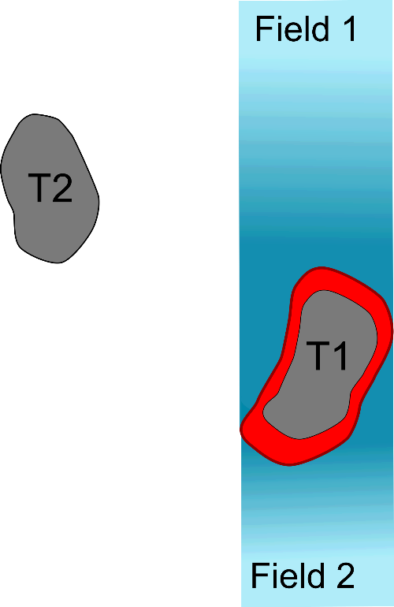
Intensity Modulated Particle Therapy Optimization for Multiple Targets

Slide 29
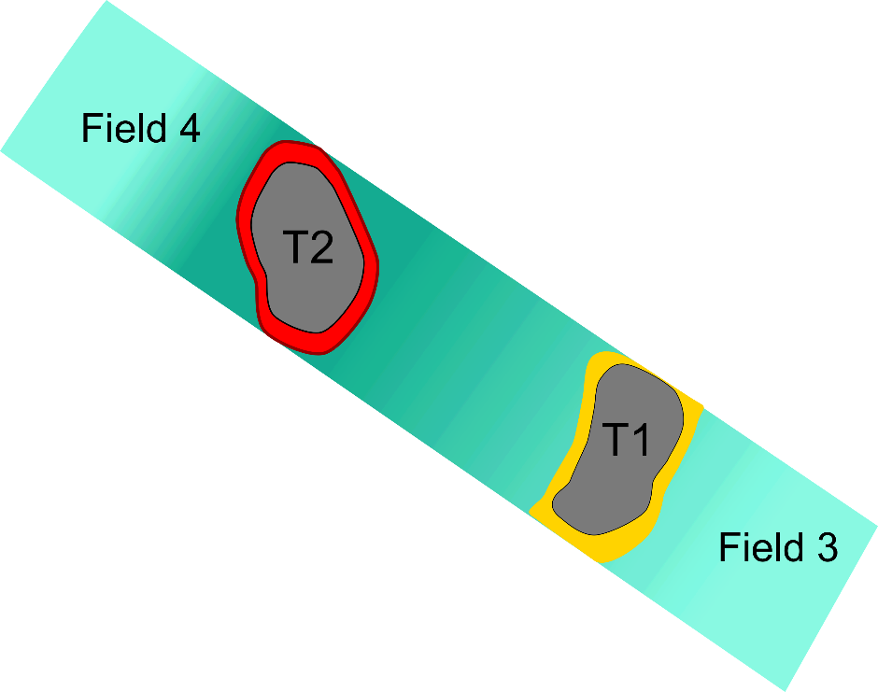
Intensity Modulated Particle Therapy Optimization for Multiple Targets

Slide 30
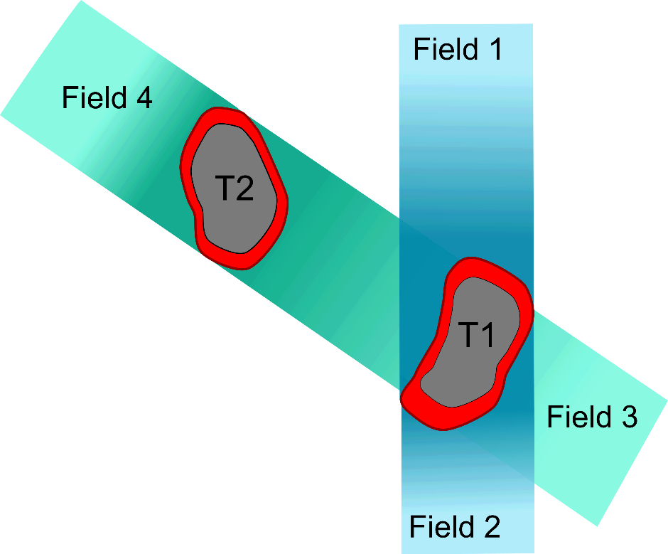
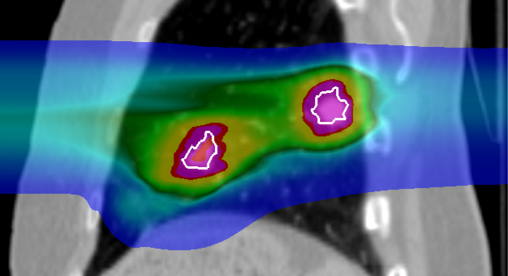
Intensity Modulated Particle Therapy Optimization for Multiple Targets

Slide 31
Patient Data
8 patients, 24 tumors
3 tumors in 2 patients received 3 x 9 Gy
1 tumor received 5 x 7 Gy
All others 1 x 24 Gy
Average tumor volume: 4.1 cm³
Average tumor motion: 5.9 mm
Several critical organs in close vicinity to the tumor
Intensity modulated particle therapy optimization

Slide 32
Dose calculation
SBRT single treatment plan
PT 8 dose calculation per patient:
2 optimizations, each 4 breathing patterns
Dose escalation for 3 patients to 1 x 24Gy

Slide 33
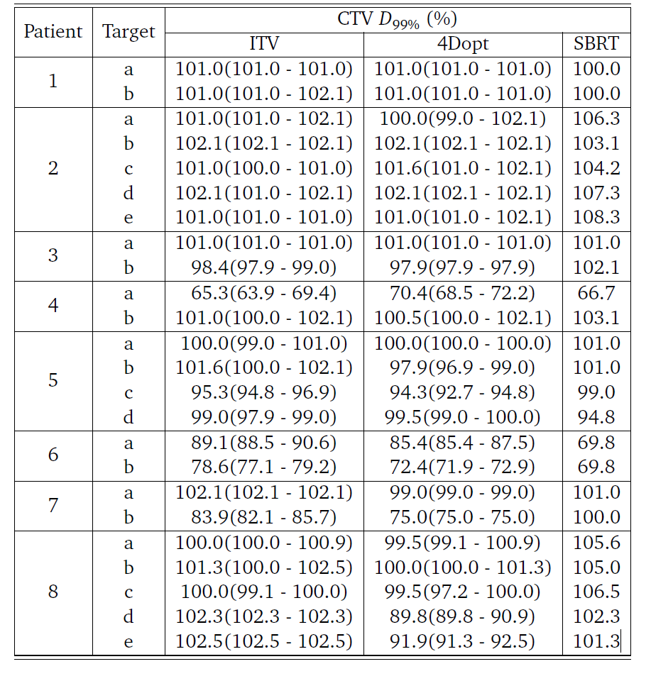
Results – Dose to the Tumors

Slide 34
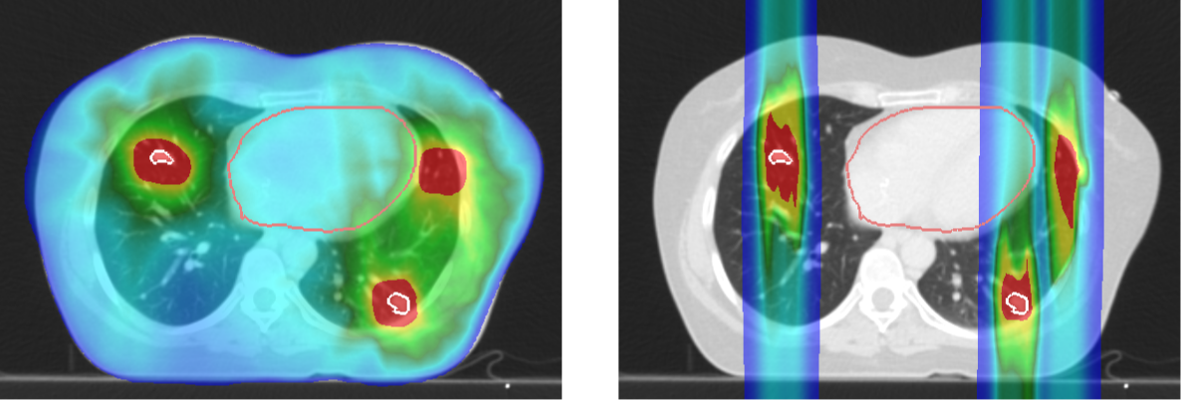
Results - Example
SBRT
PT

Slide 35
Results – Dose to the Tumors

Slide 36
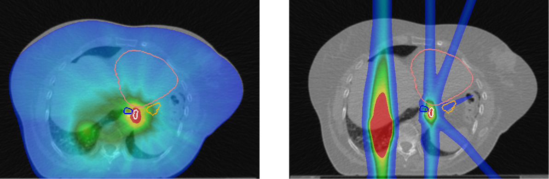
Results - Example
Heart
Heart
Esophagus
Stomach
Esophagus
Stomach
Target
Target
SBRT
PT

Slide 37
Results – Dose to Critical Organs

Slide 38
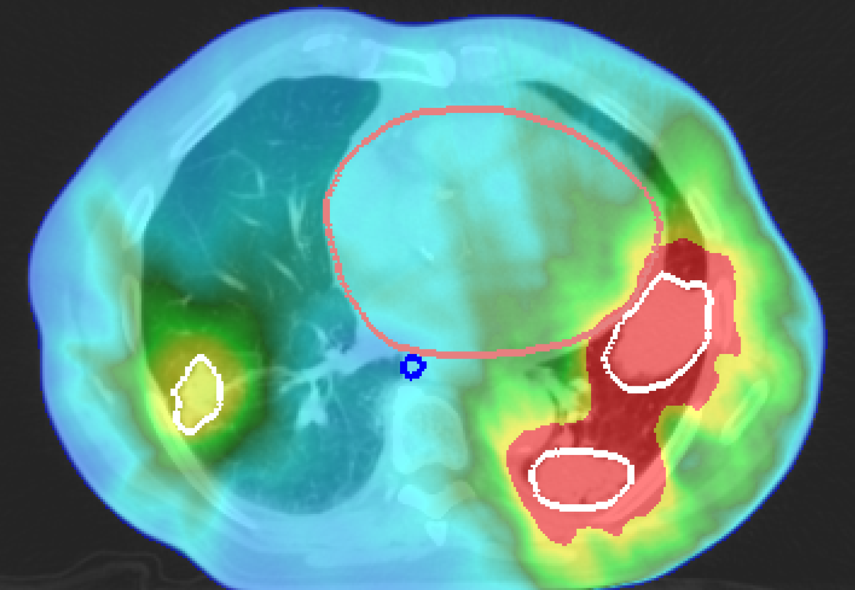
Results – Dose Escalation
1 tumor: 1 x 22 Gy
2 tumors: 1 x 21 Gy
2 tumors: 3 x 9 Gy

Slide 39
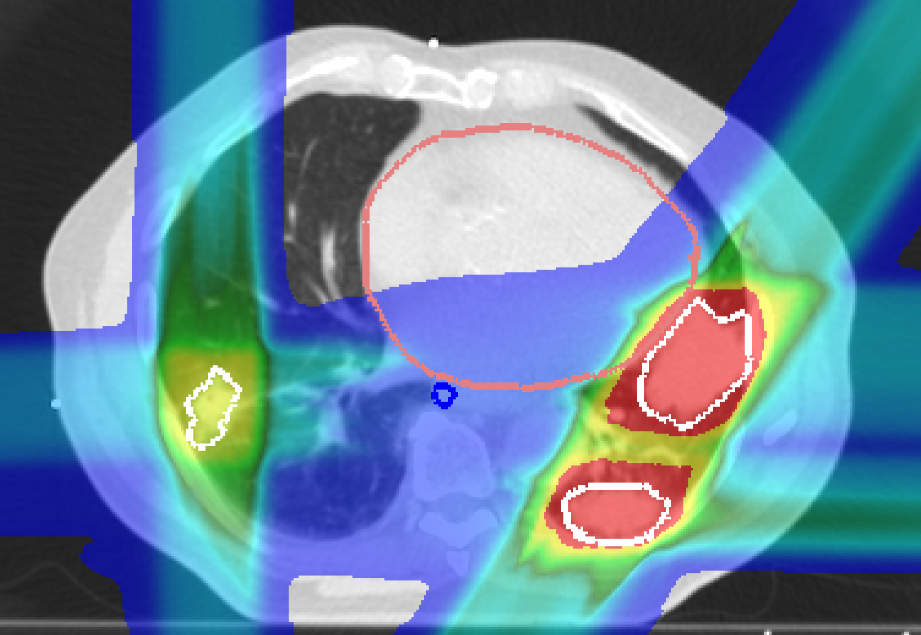
Results – Dose Escalation
1 tumor: 1 x 22 Gy
2 tumors: 1 x 21 Gy
2 tumors: 3 x 9 Gy
5 tumors: 1 x 24 Gy

Slide 40
Results – Dose Escalation

Slide 41
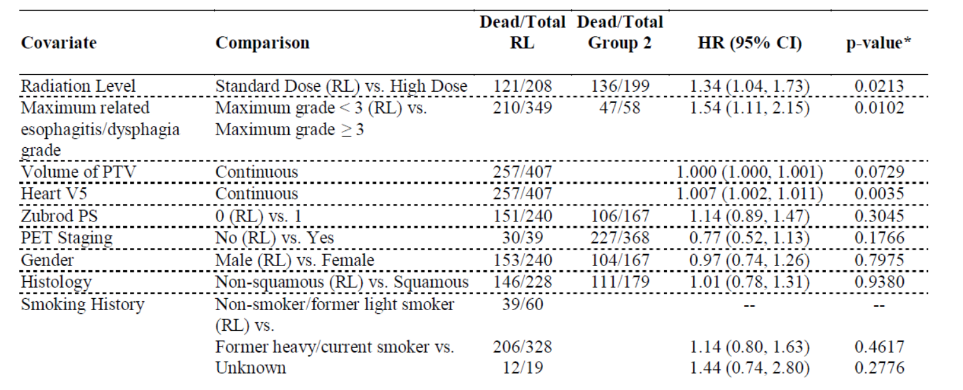
Clinical Trial RTOG 0617

Slide 42
Clinical Trial RTOG 0617

Slide 43
Clinical Trial RTOG 0617

Slide 44
Clinical Trial RTOG 0617

Slide 45
Clinical Trial RTOG 0617

Slide 46
Outline
Introduction
Lung Cancer Patients – General Group
Lung Cancer Patients with Multiple Tumors
Conclusion & Outlook

Slide 47
Outline
Introduction
Lung Cancer Patients – General Group
Lung Cancer Patients with Multiple Tumors
Conclusion & Outlook

Slide 48
Conclusions
PT delivers the same dose to tumors as SBRT,
while depositing significantly less dose to normal tissue.
Patients with large or multiple tumors would especially benefit from PT
PT could deliver full ablative dose in single fraction, where SBRT could not
PT should be considered as a treatment modality for lung cancer patients

Slide 49
Outlook
Phase III Randomized Trial Comparing Overall Survival After Photon Versus Proton Chemoradiotherapy for Inoperable Stage II-IIIB NSCLC (RTOG 1308), started in 2014, passive scattering proton therapy
First lung cancer patients treated with active scanning carbon-ions at NIRS, Chiba (Japan)
Löwe?

Slide 50

Acknowledgments
GSI
C. Graeff
M. Durante
A. Eichhorn
M. Prall
S. Hild
FC
J. Stroom
C. Greco
N. Pimentel
S. Vierra
UK Erlangen
C. Bert
T. Brandt
J. Wölfelschneider

Slide 51
Thank you for your attention.

